Slide 1

Introduction to Software Testing By Dr. Praveen Kantha

Slide 2
Software Testing

Slide 3
What is a Software Testing ?
Software Testing is a method to check whether the actual software product matches expected requirements and to ensure that software product is Defect free.
It involves execution of software/system components using manual or automated tools to evaluate one or more properties of interest.
The purpose of software testing is to identify errors, gaps or missing requirements in contrast to actual requirements.

Slide 4
Principles of Testing:-
All the tests should meet the customer requirements.
To make our software testing should be performed by a third party.
Exhaustive testing is not possible. As we need the optimal amount of testing based on the risk assessment of the application.
All the tests to be conducted should be planned before implementing it.
It follows the Pareto rule(80/20 rule) which states that 80% of errors come from 20% of program components.
Start testing with small parts and extend it to large parts.

Slide 5
What is Testing Strategy?
Designing effective test cases is important, but so is the strategy you use to execute them.
Should you develop a formal plan for your tests?
Should you test the entire program as a whole or run tests only on a small part of it?
Should you rerun tests you've already conducted as you add new components to a large system?
When should you involve the customer?
These and many other questions are answered when you develop a software testing strategy.

Slide 6
A Strategic Approach to Software Testing?
Testing begins at the component level and works "outward" toward the integration of the entire computer-based system.
Different testing techniques are appropriate at different points in time.
Testing is conducted by the developer of the software and (for large projects) an independent test group.
Testing and debugging are different activities, but debugging must be accommodated in any testing strategy.

Slide 7
Verification and Validation
Verification refers to the set of activities that ensure that software correctly implements a specific function. It is on going process. In each phase verification done.
Validation refers to a different set of activities that ensure that the software that has been built is traceable to customer requirements. Validation are done after software made.
Verification: "Are we building the product right?
Validation: "Are we building the right product?"

Slide 8
Organizing for Software Testing
The software developer is always responsible for testing the individual units (components) of the program, ensuring that each performs the function for which it was designed.
In many cases, the developer also conducts integration testing.
Only after the software architecture is complete does an independent test group become involved.
The role of an independent test group (ITG) is to remove the inherent problems associated with letting the builder test the thing that has been built .
Independent testing removes the conflict of interest that may otherwise be present.

Slide 9
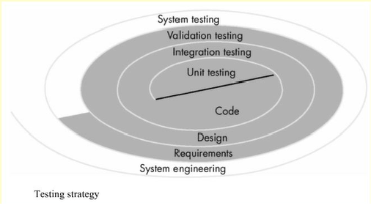
A software testing Strategy
A Strategy for Software testing may be viewed as spiral

Slide 10
A software testing Strategy
Unit testing begins at the vortex of the spiral and concentrates on each unit (i.e., component) of the software as implemented in source code.
Testing progresses by moving outward along the spiral to integration testing, where the focus is on design and the construction of the software architecture.
Taking another turn outward on the spiral, we encounter validation testing, where requirements established as part of software requirements analysis are validated against the software that has been constructed.
Finally, system testing, where the software and other system elements are tested as a whole.

Slide 11
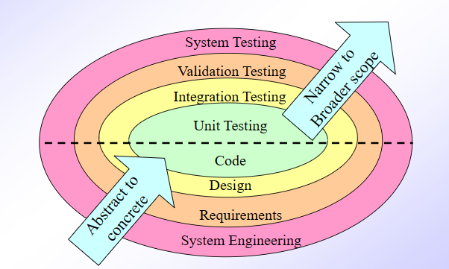
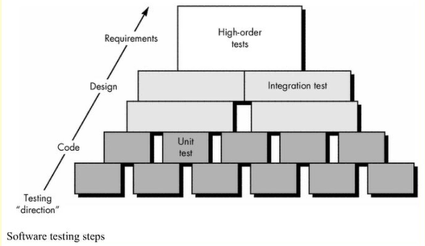
A software testing Strategy
Unit test >> white-box techniques
Integration test >> black-box + limited white-box
Validation test >> black-box techniques
White-box : The developer perform the white box testing. In this testing developer have the knowledge about internal architecture of system.
Black Box Testing : The test engineers perform the black box testing. In this testing tested no need to know internal architecture of system. They only give the input and check the result.

Slide 12
Unit Testing
Unit testing focuses on the smallest unit of software design—the software component or module.
It is mainly focused on the functional correctness of standalone modules.
The unit test is white-box oriented, and the step can be conducted in parallel for multiple components.
The goal of unit testing to separate each part of the program and test that the individual parts are working correctly and as intended.
Unit tests are great for confirming the correctness

Slide 13
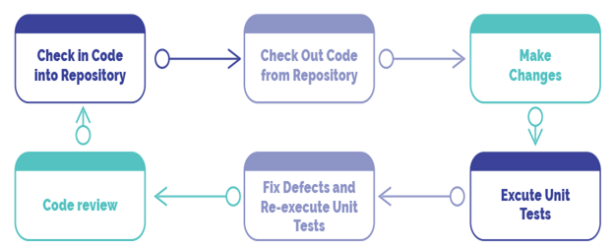
Unit Testing Life Cycle

Slide 14
Types of Unit Testing:
There are 2 types of Unit Testing: Manual, and Automated.
Manual Testing
Manual testing includes testing a software manually, i.e., without using any automated tool or any script.
Testers use test plans, test cases, or test scenarios to test a software to ensure the completeness of testing.
Automation Testing
It involves using specialized tools to test scripts automatically.
It's the most widely-accepted strategy for improving software testing's speed, output, and breadth of tests.

Slide 15
Unit Testing Tools :
There are several automated unit test software :
Junit: Junit is a free to use testing tool used for Java programming language. This tool test data first and then inserted in the piece of code.
NUnit: NUnit is widely used unit-testing framework use for all .net languages. It is an open source tool which allows writing scripts manually.
JMockit: JMockit is open source Unit testing tool. This tool offers Line coverage, Path Coverage, and Data Coverage.
EMMA: EMMA is an open-source toolkit for analyzing and reporting code written in Java language.

Slide 16
Unit Testing - Advantages:
Reduces Defects in the Newly developed features or reduces bugs when changing the existing functionality.
Reduces Cost of Testing as defects are captured in very early phase.
Improves design and allows better refactoring of code.
Unit Tests, when integrated with build gives the quality of the build as well.

